Slide 1


Slide 2
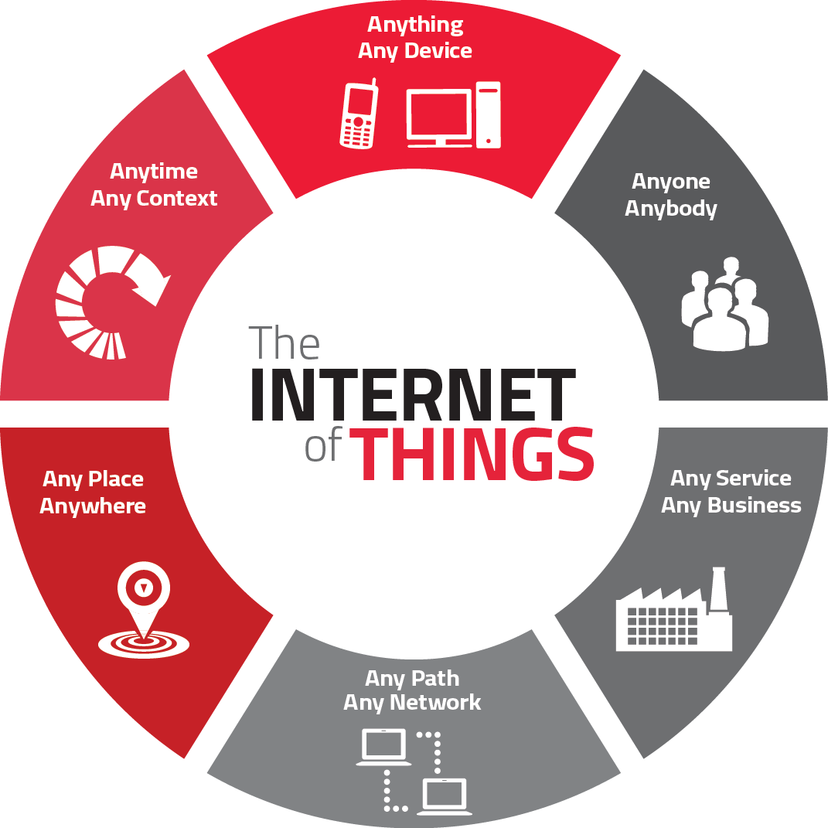
Notes:
The term ‘Internet of Things’ refers to a wireless connection between objects which enables the internet to reach out into the real world of physical objects.

Slide 3


H 2 H
H 2 M
M 2 M
The IoT is a scenario in which objects, animals or people are provided with unique identifiers
and the ability to transfer data over a network without needing a Human to Human or
Human to Machine Interaction.

Slide 4
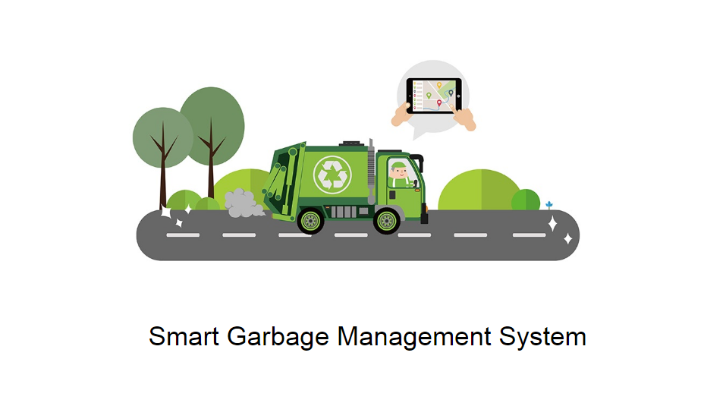

Slide 5


Slide 6
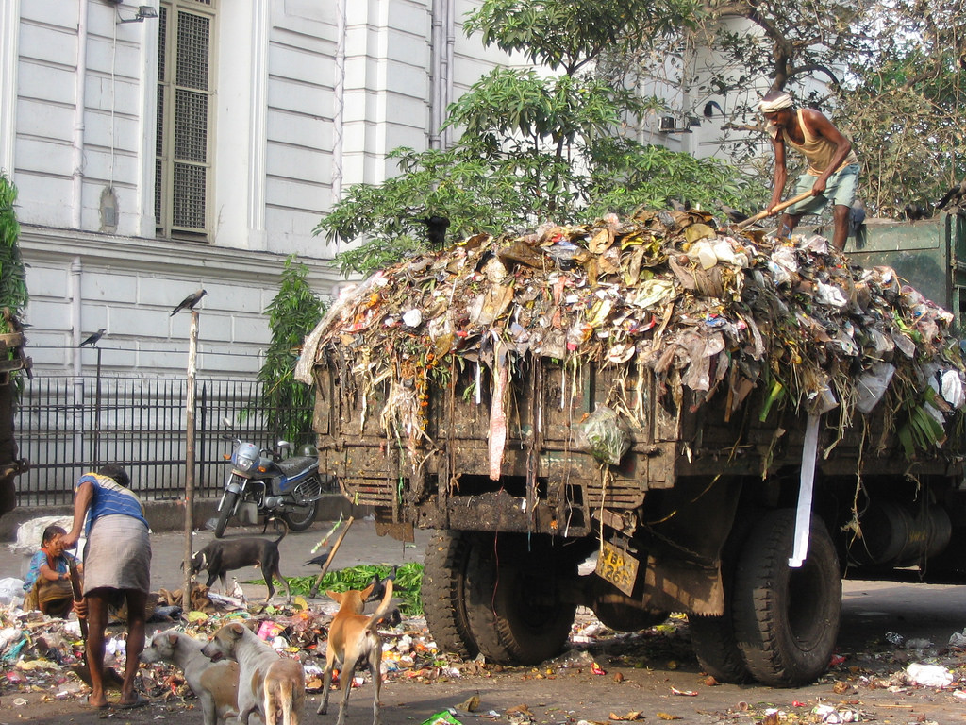
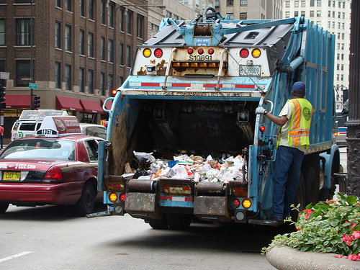

Slide 7
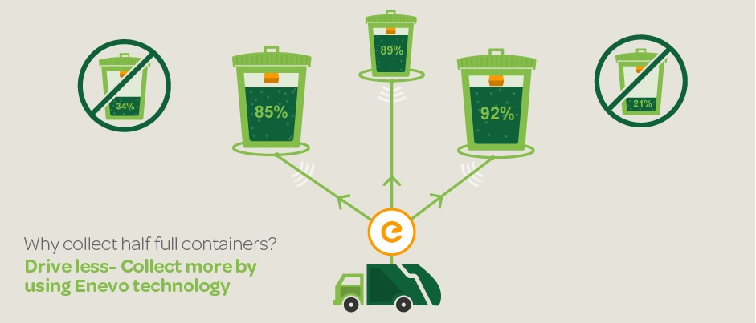

Slide 8
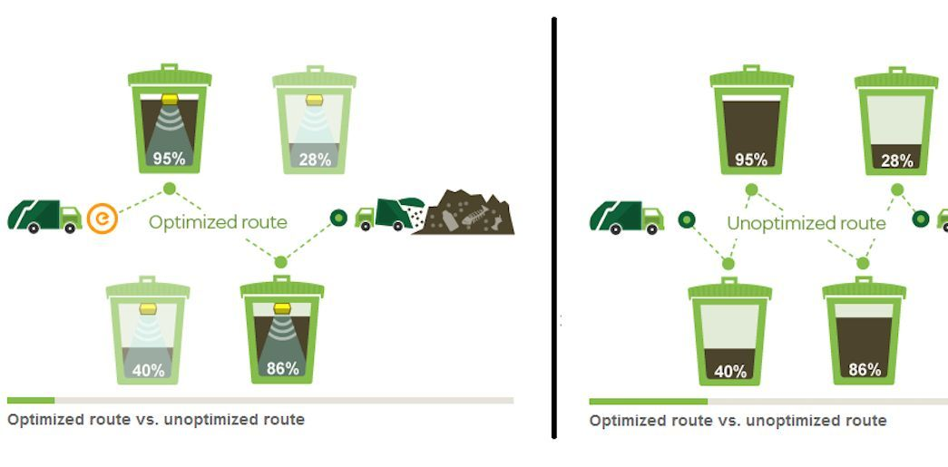

Slide 9


Slide 10
Know the fill-level of the containers at all times
Cut the service costs by up to 50%
Provide a world class service
Reduce the organization’s carbon footprint
Ultrasonic & Infrared fill-level, geo-location/GPS
Eliminate over-filling by collecting before it could arise
Send optimized routes directly to the drivers
Arduino Chipset and all other sensors weigh less than 300gm & easily mounted to any container

Slide 11
Ultrasonic Sensors measures up to 7.5m in depth
Full management of the container assets and generating smart routes for the drivers (using Google maps) !
Whenever the waste bin gets filled this is acknowledged by placing the circuit at the waste bin
The signal is transmitted to the receiver at the desired place in the area

Slide 12
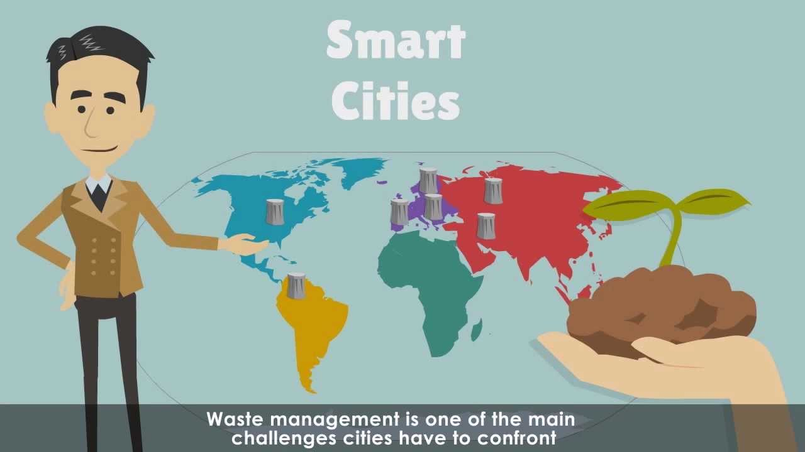
Benefits for smart cities

Slide 13
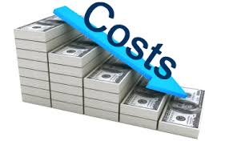

Slide 14
The initial goal is to try in one city then replicate to multiple cities
The product is designed using most open source components there by any city can scale it up and manufactured in large volume
The system will have its own business model to create sustainable revenue
The Cost of Arduino chip set and other hardware is minimal as compared to the service they provide
The cost associated with the project is only at the setup of the project, as Arduino chip set, WIFI modem, ultrasonic sensors and other hardware is needed

Slide 15
Different Modules
Administrator Module
Municipal Authority Module
Garbage Collector Driver Module

Slide 16

Administrator Module

Slide 17
Used by Main Administrator – Single User
Controls all the Functionalities
Controls the Permissions of Different Users
Can Provide Access to new Users in other Modules

Slide 18
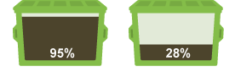
Municipal Authority Module
Used by the Authority of Municipal Corporation
Can view the GUI based Level of Garbage in the Dustbin

Slide 19
Can View the Map View status of the Dustbins
Can view the Dustbin Details – Dustbin ID, Threshold Value, Location
Can View the Details of all the Drivers located in their Area
Can Update the Dustbin and Drivers Details

Slide 20
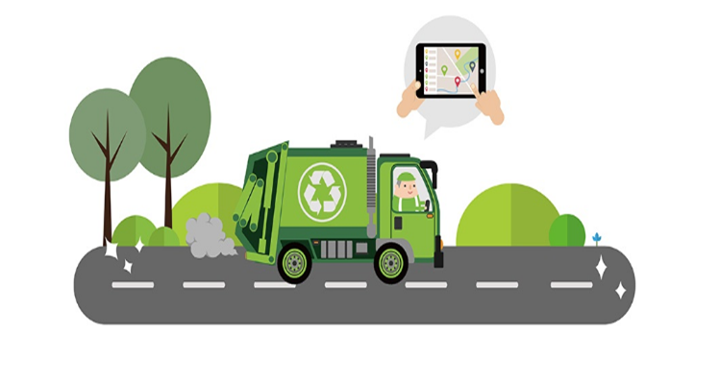
Garbage Collector Driver Module

Slide 21
Used by the Drivers on their Smartphones
Can View the Map View status of the Dustbins
Can view the Dustbin Details – Dustbin ID, Threshold Limit, Location
Informed Through Text Message when Threshold Limit Exceeds

Slide 22
Functionality Through Example

Slide 23
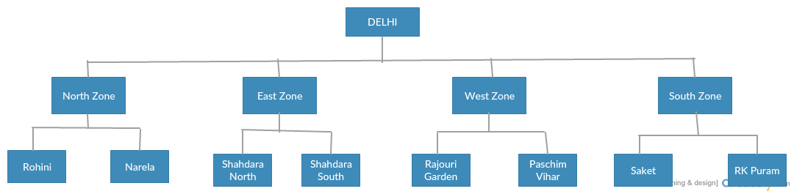
Municipal Corporation of Delhi
ADMIN
MUNICIPAL ADMIN
DRIVER

Slide 24
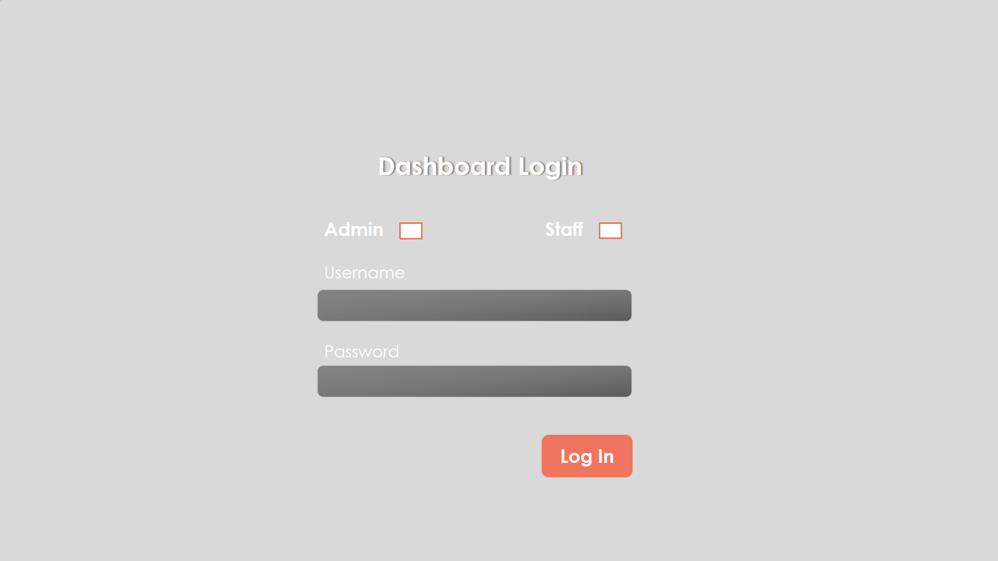

Slide 25
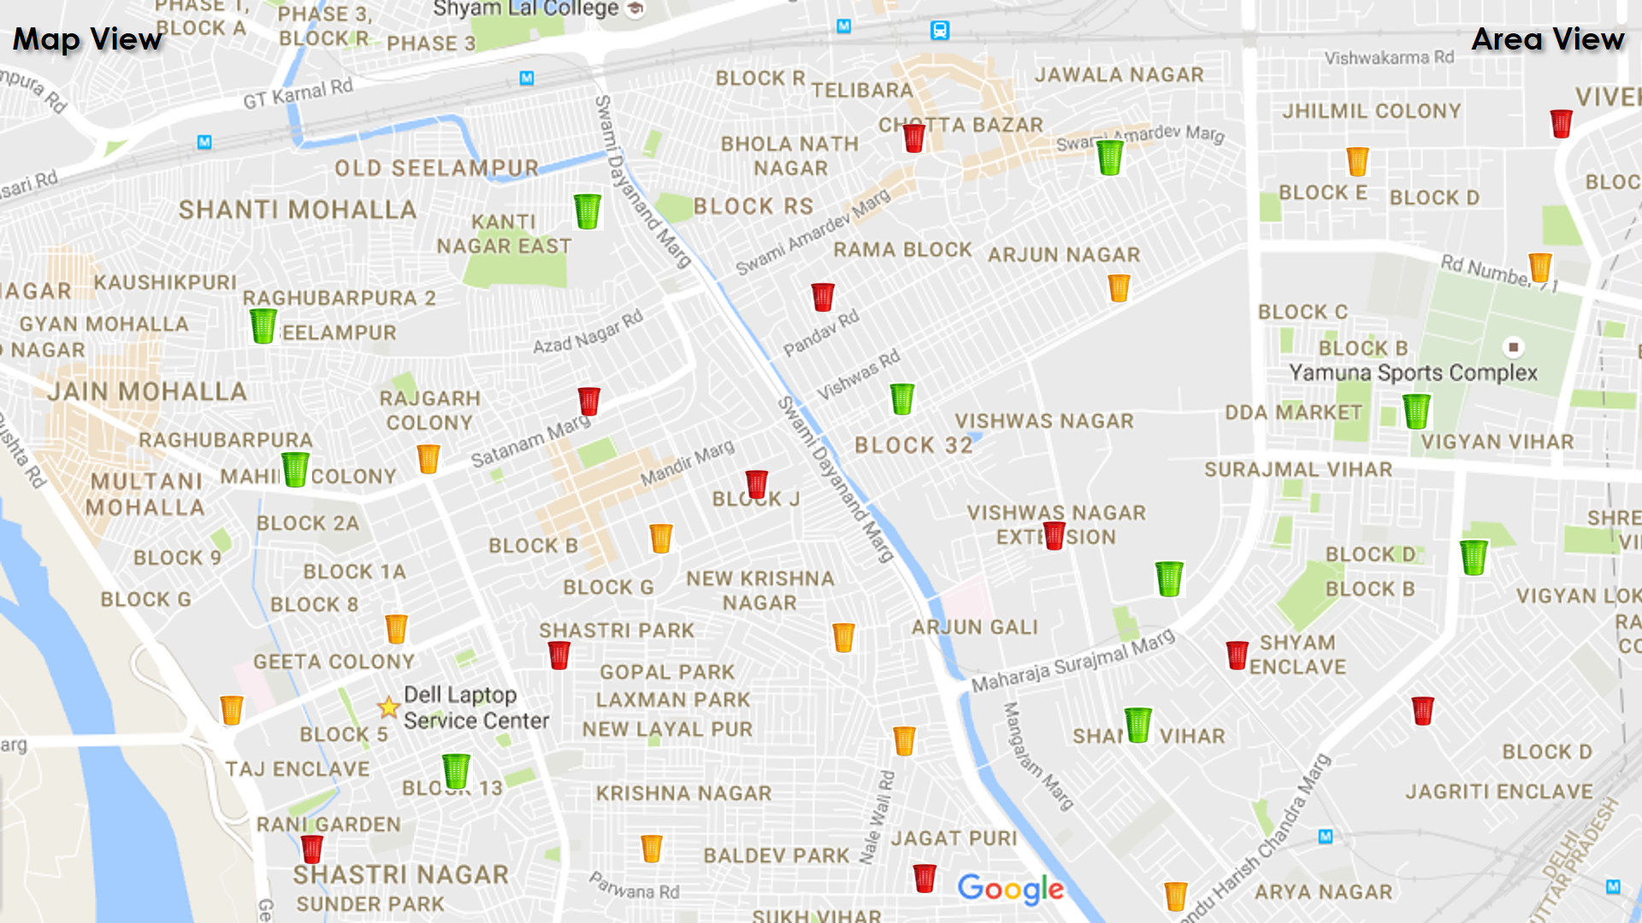

Slide 26
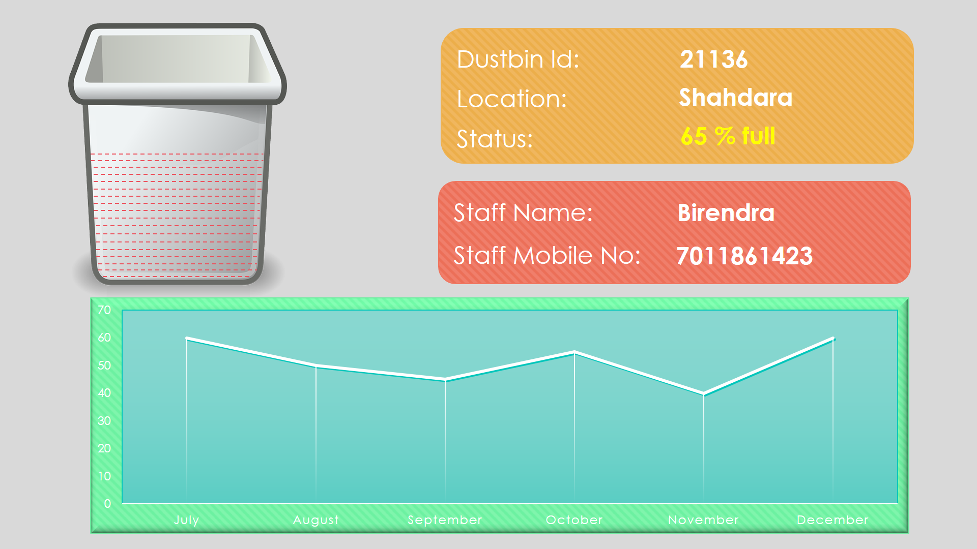

Slide 27
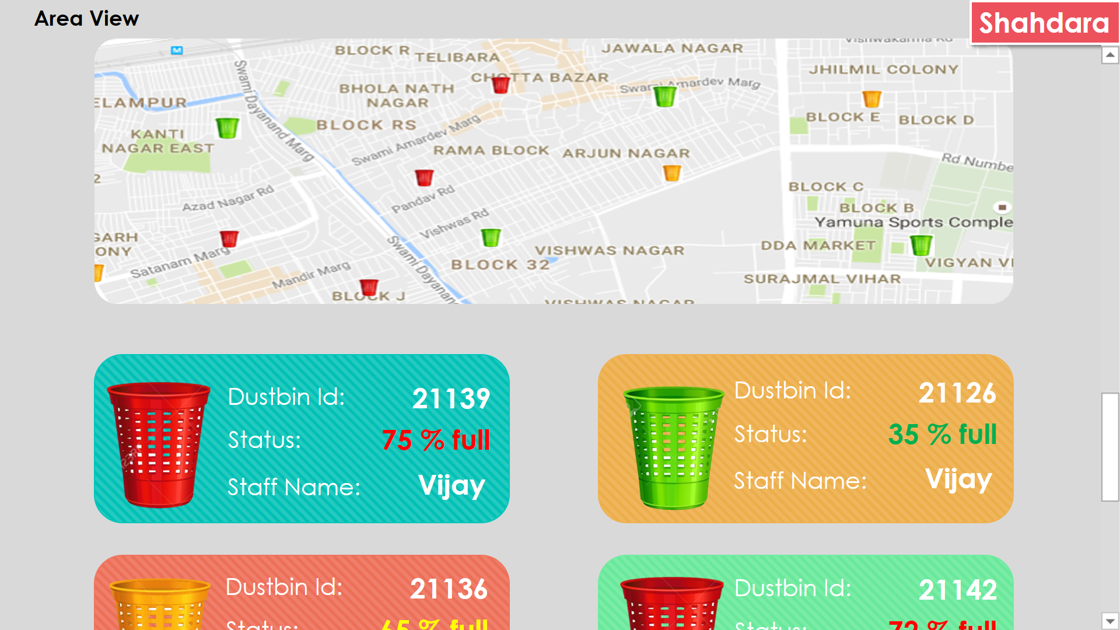

Slide 28
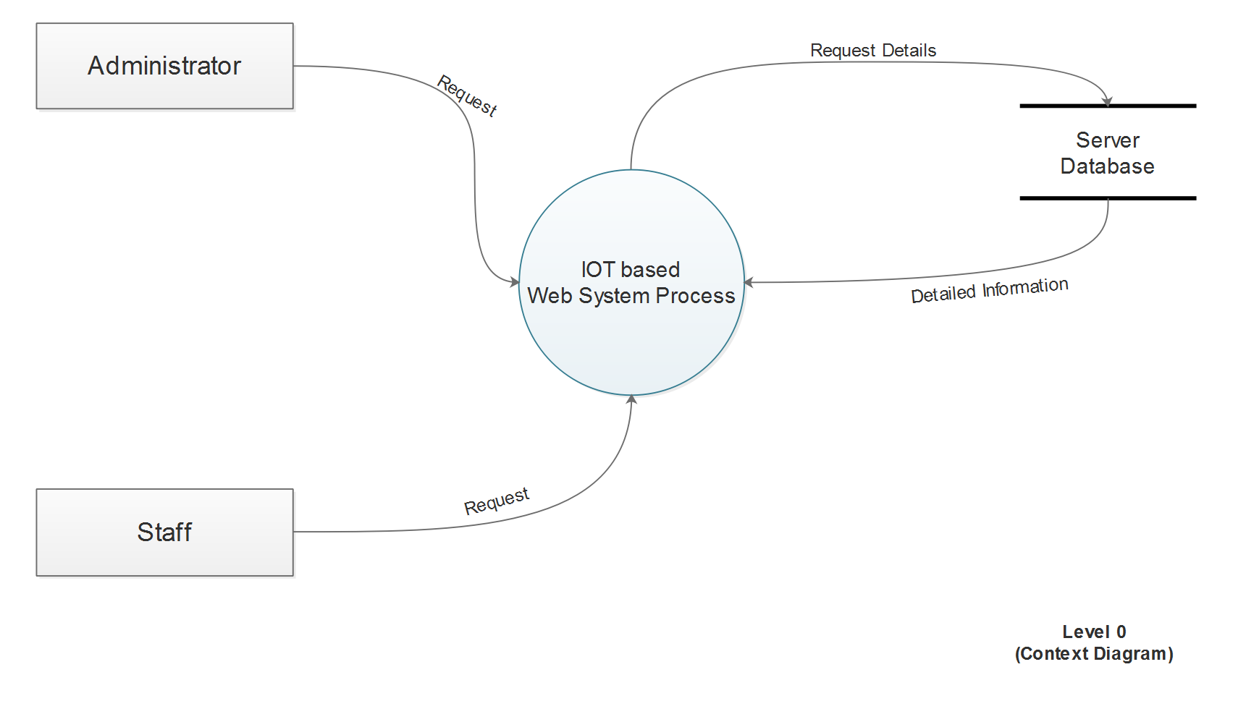

Slide 29
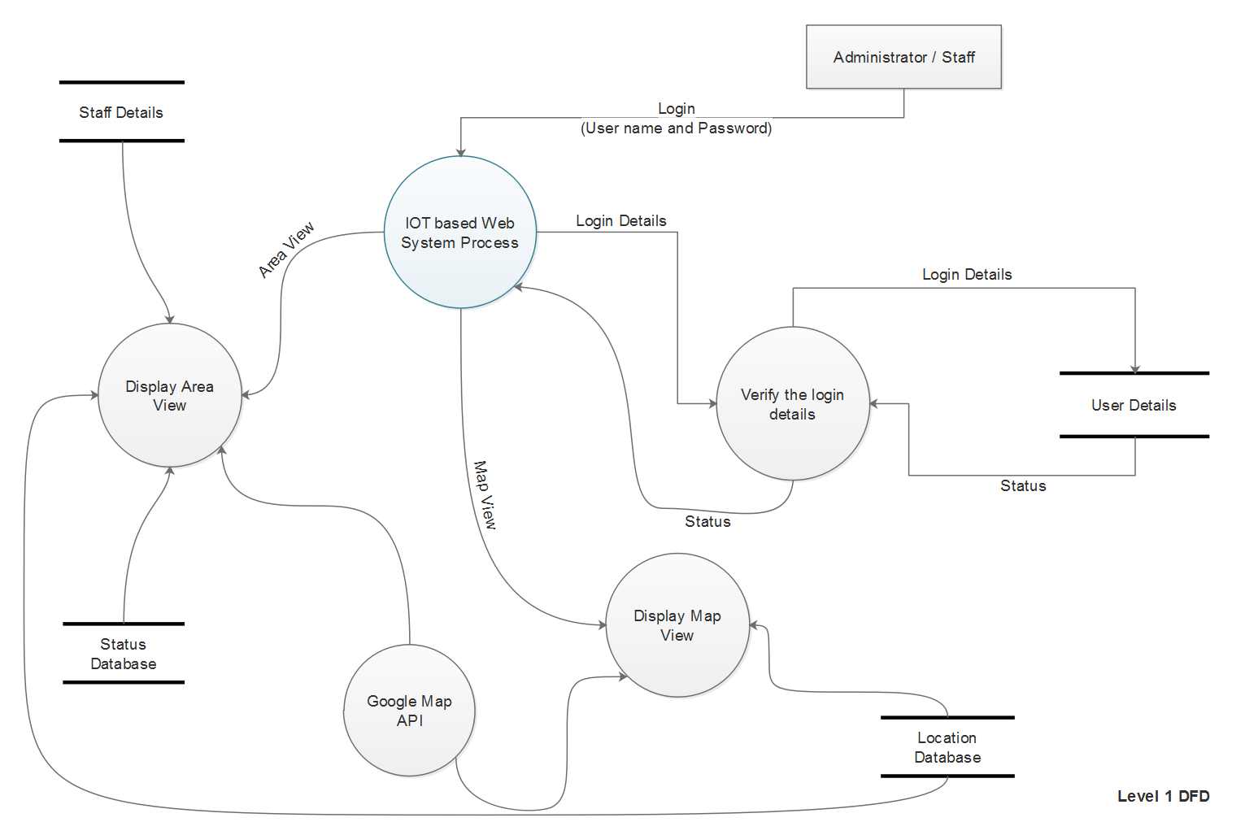

Slide 30
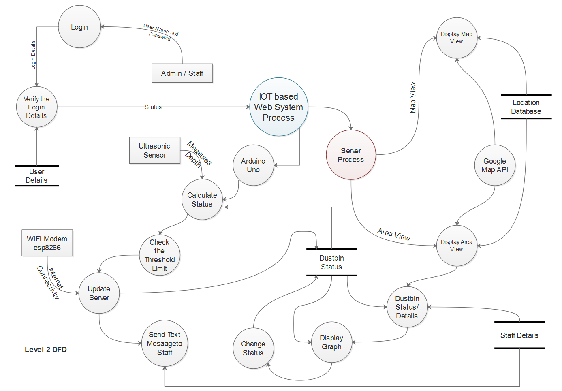

Slide 31
HARDWARE SPECIFICATION

Slide 32
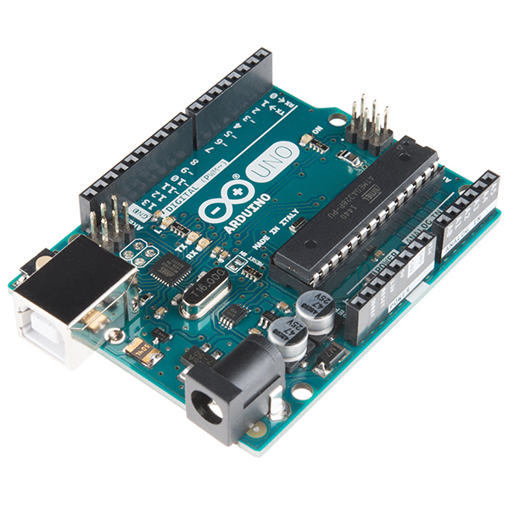
Arduino uno
Notes:
Arduino Uno is a microcontroller board.

Slide 33
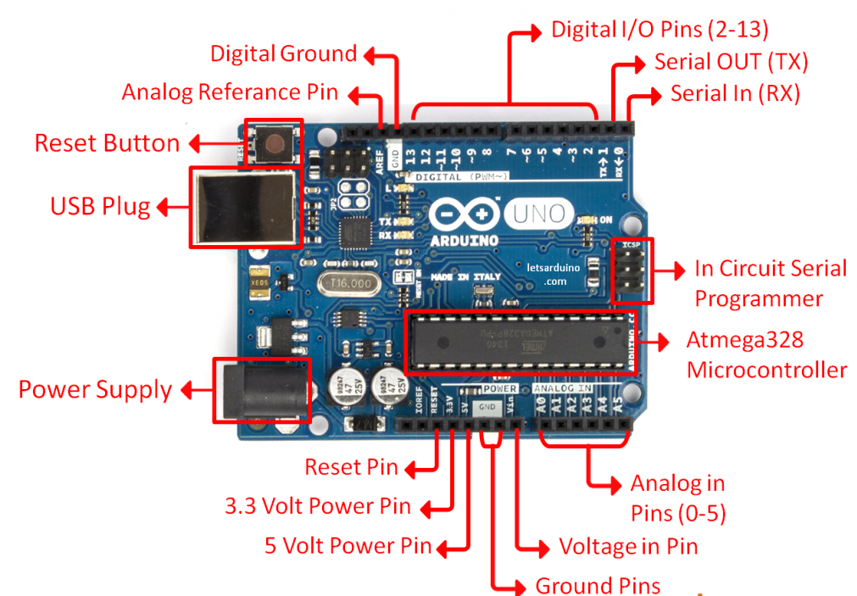
Notes:
It has 14 digital input/output pins (of which 6 can be used as PWM outputs), 6 analog inputs, a 16 MHz quartz crystal.
USB connection, a power jack, an ICSP header and a reset button

Slide 34
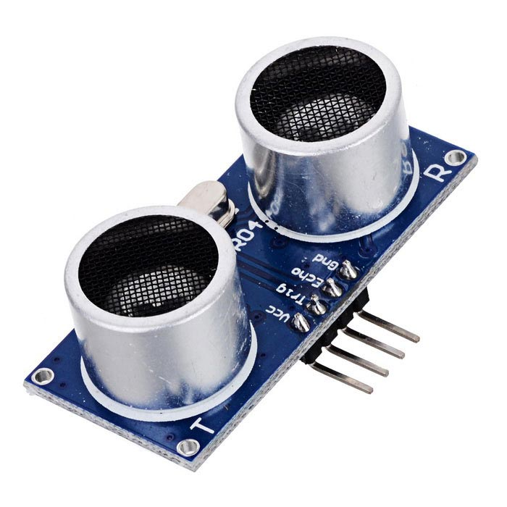
Ultrasonic sensor
Notes:
The Ultrasonic Sensor sends out a high-frequency sound pulse and then times how long it takes for the echo of the sound to reflect back.

Slide 35
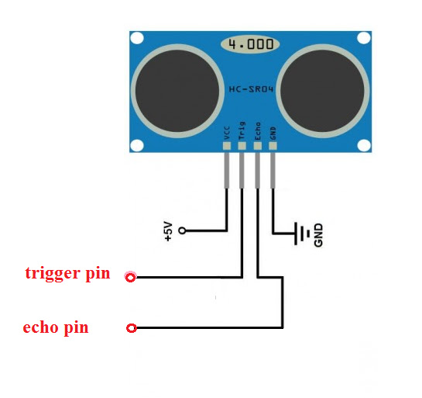
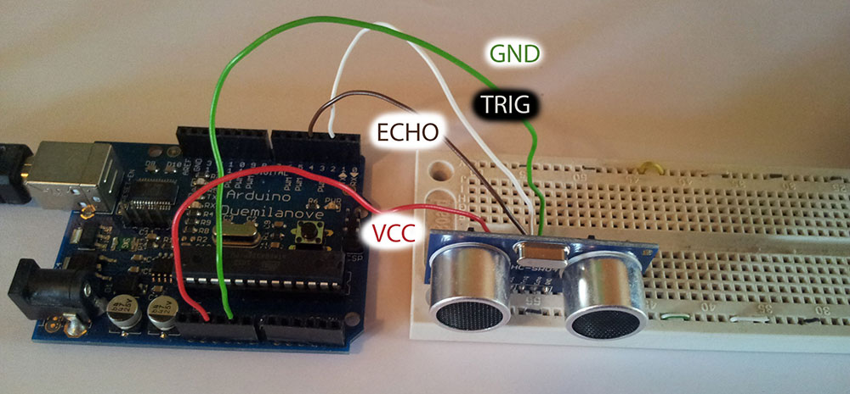
Notes:
The Trig pin will be used to send the signal and the Echo pin will be used to listen for returning signal.

Slide 36
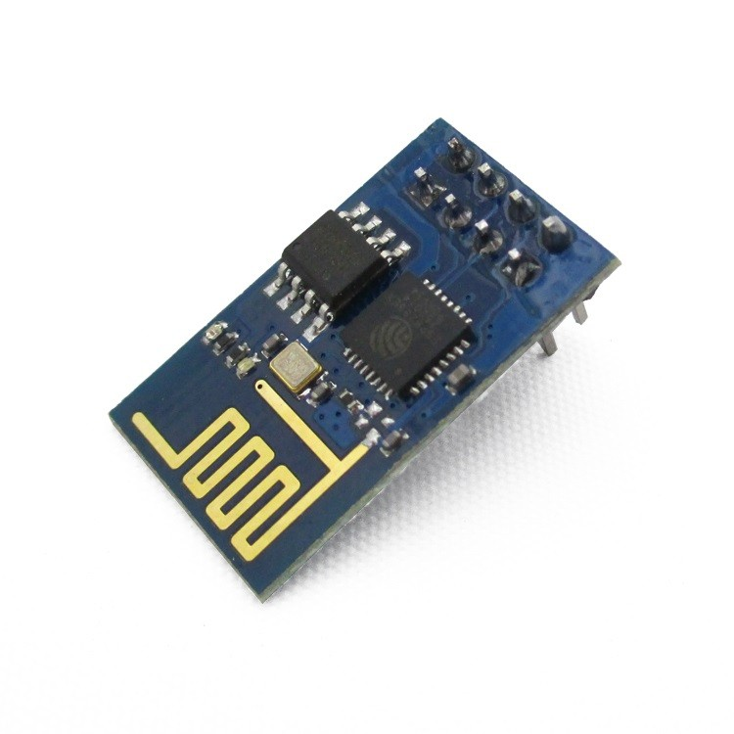
WIFI MOUDULE ESP8266
Notes:
ESP8266 WiFi Module is a self contained SOC with integrated TCP/IP protocol stack
It can give any microcontroller access to your WiFi network

Slide 37
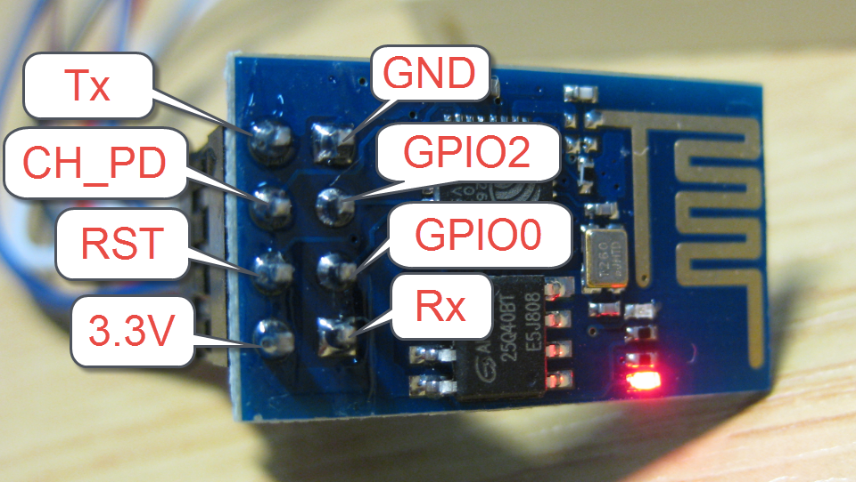

Slide 38
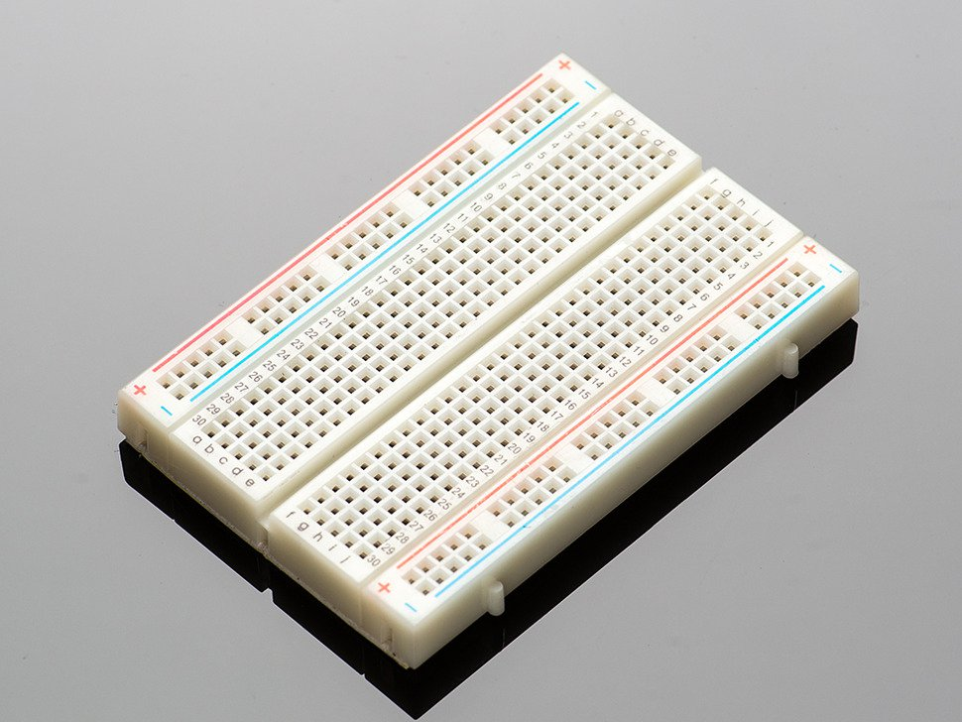
Breadboard
Notes:
It is a construction base for prototyping of electronics
It does not require soldering
It is reusable

Slide 39
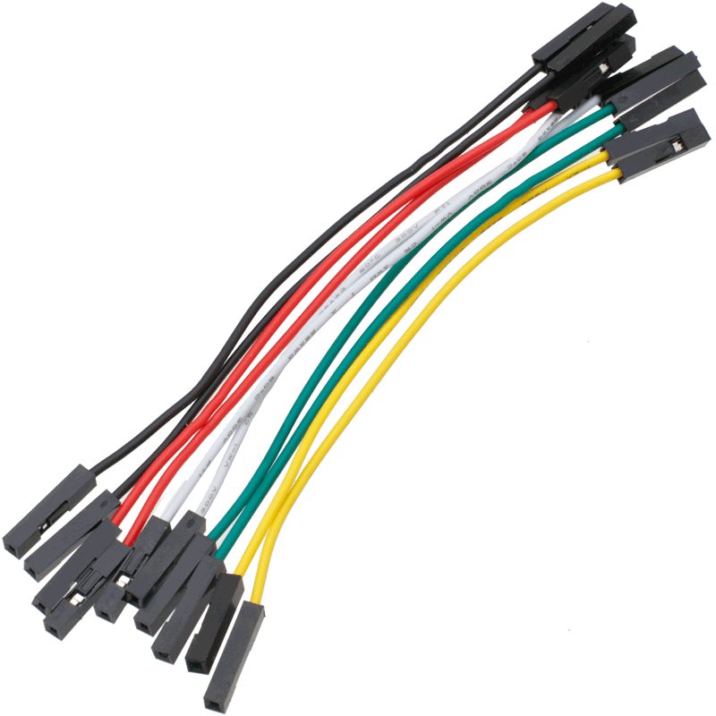
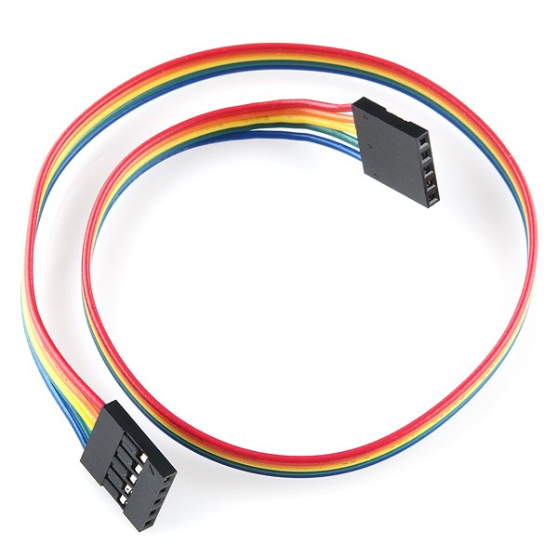
Jumper wires
Notes:
Jump wire is an electrical wire or group of them in a cable with a connector or pin at each end
It is used to interconnect the components of a breadboard

Slide 40
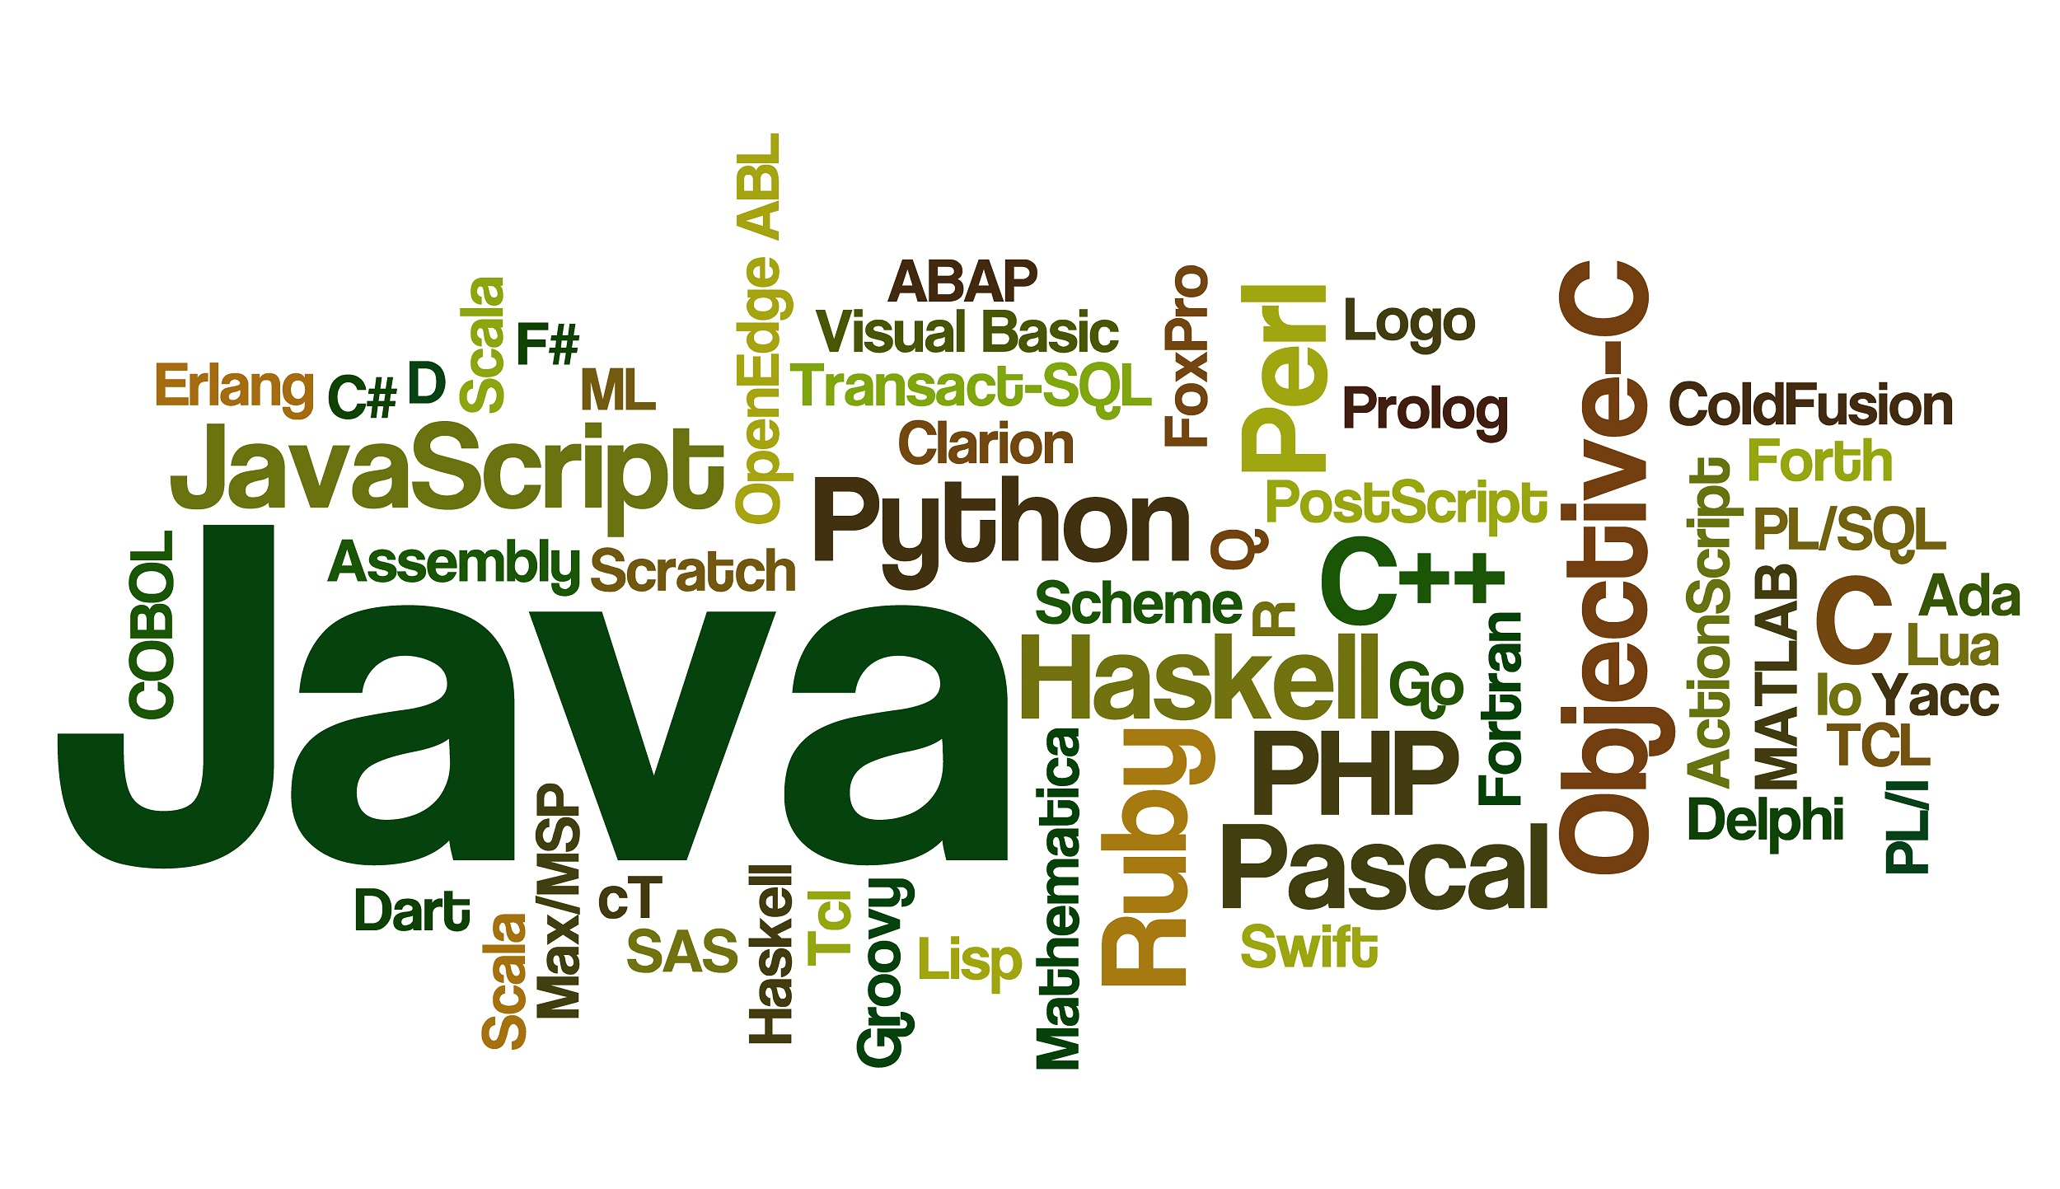
Programming Implementation

Slide 41
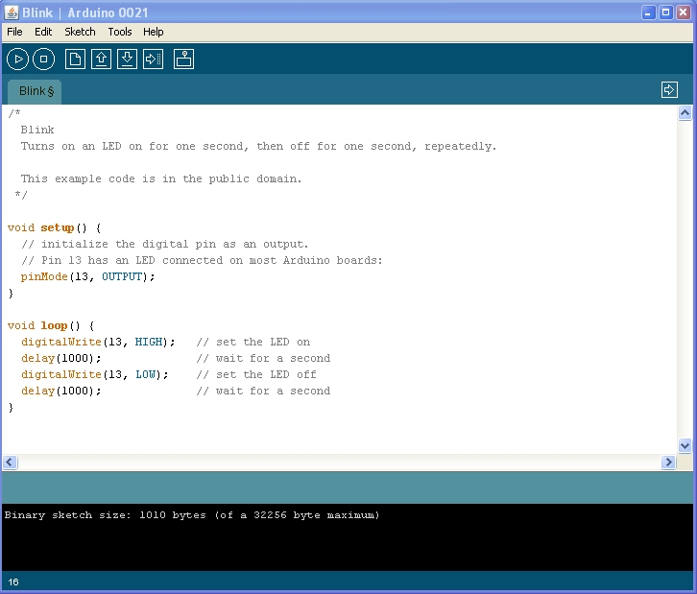
ARDUINO IDE

Slide 42
Arduino IDE
It’s an open source IDE
It contains a text editor for writing code, a message area, a text console, and many other useful functions that makes it easy to write code and upload it to the board
It runs on Windows, Mac OS X, and Linux

Slide 43
PHP and MYSQL
Used to fetch the Data from the Database Server
Used to send Text Messages to Driver through Server
Used to Display Data to Different Modules

Slide 44
HTML,CSS And JavaScript
Used for the Front End Development
Used to Display GUI based Level of Garbage in Dustbin
Used to Display Map View

Slide 45
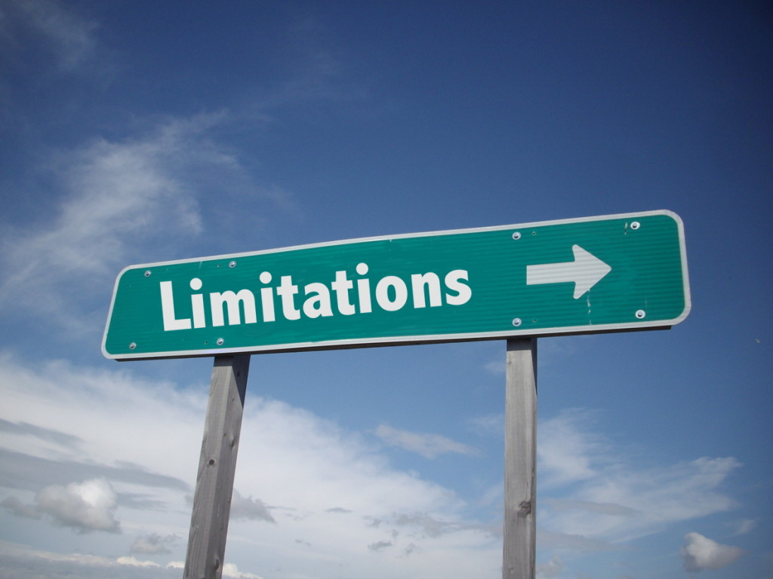

Slide 46
Availability of resources: The setup of the project requires an Arduino chip set, WIFI modem, ultrasonic sensors and other hardware are needed.
Trial and testing of the project requires specific environment and labs equipped with proper facilities.
Implementation of the project requires prescriptive regulations to be legally and operationally enforceable. - whether the project if comprehensive or not - whether the project is supported by the scientific data provided in the prescription to allow the development of specific standards which are protective of human health and
environemnt

Slide 47
Scope of the project: The project can be implemented only in the metropolitan cities and some tier II cities. Small towns and tier III cities are out of the bound as technical feasibility is not possible.
Effective management of human resources: Skilled and trained people are required to operate the whole mechanism.

Slide 48
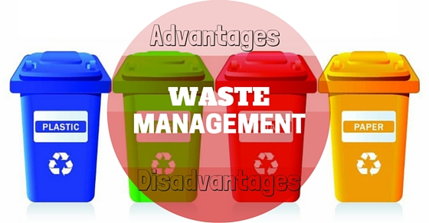

Slide 49
Advantages
Reduce the cost and complexity of the edge devices.
Gateway can act as hub for things with different data standards and wireless protocols that provide uniform face to the devices.
Easy to control and monitor as the whole system is centralized.
Gateway can control what data to be sent to the internet and provide information security
Convinient to link legacy equipment into the IoT.

Slide 50
Disadvantages
One of more tier will add higher complexity in the integration
Resources still reside locally comparing with using cloud technology
As the system is centralized, failure of central hub will bring down the network
Disposal of e waste generates toxic substances which is harmful to both environment and humans.
Implementing the system on a broad level will take require a lot resources both financially and technically

